Slide 1

QUALITY CHECK OF CROPS
Using Weather prediction
Purushottam Mathur (19BEE0299)
VIKAS KUMAR NIGAM (19BEE0261)
SHAKSHAM TUNWAL (19BEE0282)
SHUBHAM MITTAL (19BEE0286)

Slide 2
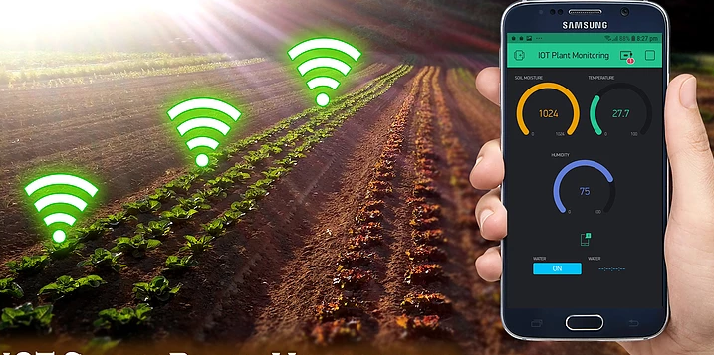

Slide 3
Abstract
Nowadays there is a real need for the reformation in Primary sector of Farming so, we have thought of making a project that can check the quality of the crop as the farmer is asked to enter the crop’s location which will thereafter, gets classified through meteorological data of the weather condition & it’ll classify the suitable parameters of the crop finally leading to prediction of the quality of crop.
By this, we can also connect them to customers directly with an interface & they would also provide reviews for the product. This will reduce most of their problems & leading them to live a profitable lifestyle.
Finally, this could help for the improvisation in the standards of society & our country.

Slide 4
INTRODUCTION
Weather forecasting is the application of science and technology to predict the conditions of the atmosphere for a given location and time. Human beings have attempted to predict the weather informally for millennia and formally since the weather forecasts are made by collecting quantitative data about the current state of the atmosphere at a given place and using meteorology to project how the atmosphere will change , ANNs are particularly appealing because of their ability to model an unspecified nonlinear relationship between load and weather variables.
This techniques would be proved helpful in the field of Crop quality check as weather condition plays a very important role in the crop growth. To add intelligence for system as human we have given a study platform called Artificial Neural networks, Machine learning, rule based techniques where there exist ample impetus to study the weather occurrence and prediction.
We have used Regression analysis for making predictions & determine the output precisely. Regression equations are actually a crucial part of the statistical output after you fit a model. We require certain relevant variables, formulate a model, and then evaluate ow well the model fits the data.

Slide 5
METHODOLOGY/ALGORITHM
Neural network provides methodology of solving highly non-linear problems. Inspired by brain as ANN is interconnection of highly non-linear neuron . The neuron are connected to each other via link. This network is trained using Back-propagation algorithm.
In Machine learning, we build a model based on labeled training data. The model is then used for mapping new examples. So, based on the observed weather patterns from the past, we tried to build this model and used to predict the weather.
In Back propagation algorithm the error is back propagated and respectively the weights are adjusted so as to reduce the error. The iteration continues until target value with minimum error is reached.

Slide 6
Linear regression is the most basic and frequently used predictive model for analysis. Regression estimates are generally used to describe the data and elucidate relationship between one or more independent and dependent variables. Linear regression finds the best-fit through the points, graphically. Hence, we tried using regression model to describe our output in the form of relative graphs.
Initially, we tried to create different models & compare all the 3 models as per the classified parameters to define the weather condition. Then, we made use of a Classifier. It was basically used to classify which of the given parameters are genuinely useful for a particular crop. This helped us in getting somewhat accurate & precise information with percentage ratio of the crop. Finally after the comparisons & combinations, we found out the proper crop quality with weather check.
As the output is displayed, we can classify if the particular crop is healthy to use or not i.e. predict the yield of crops.

Slide 7
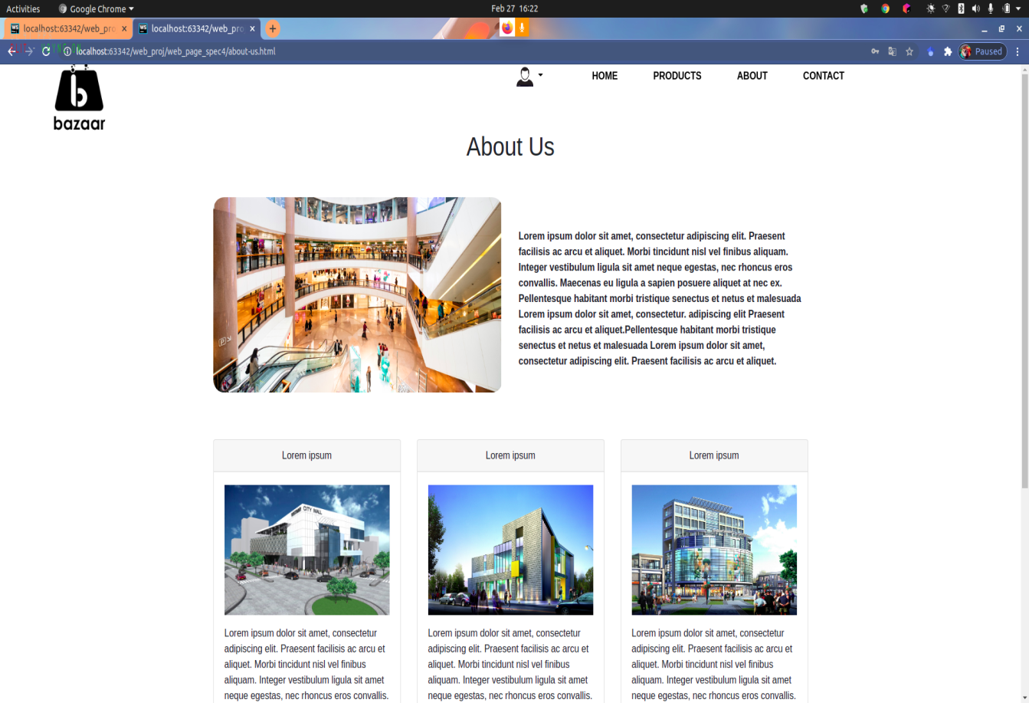

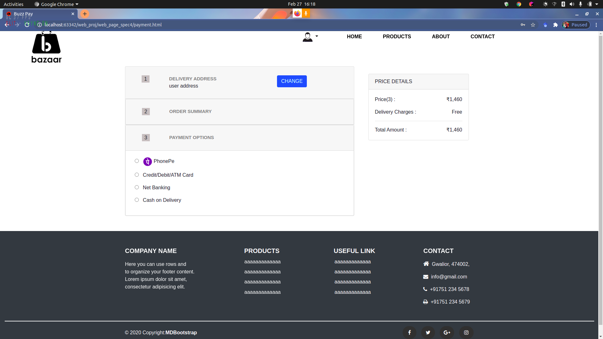

Slide 8
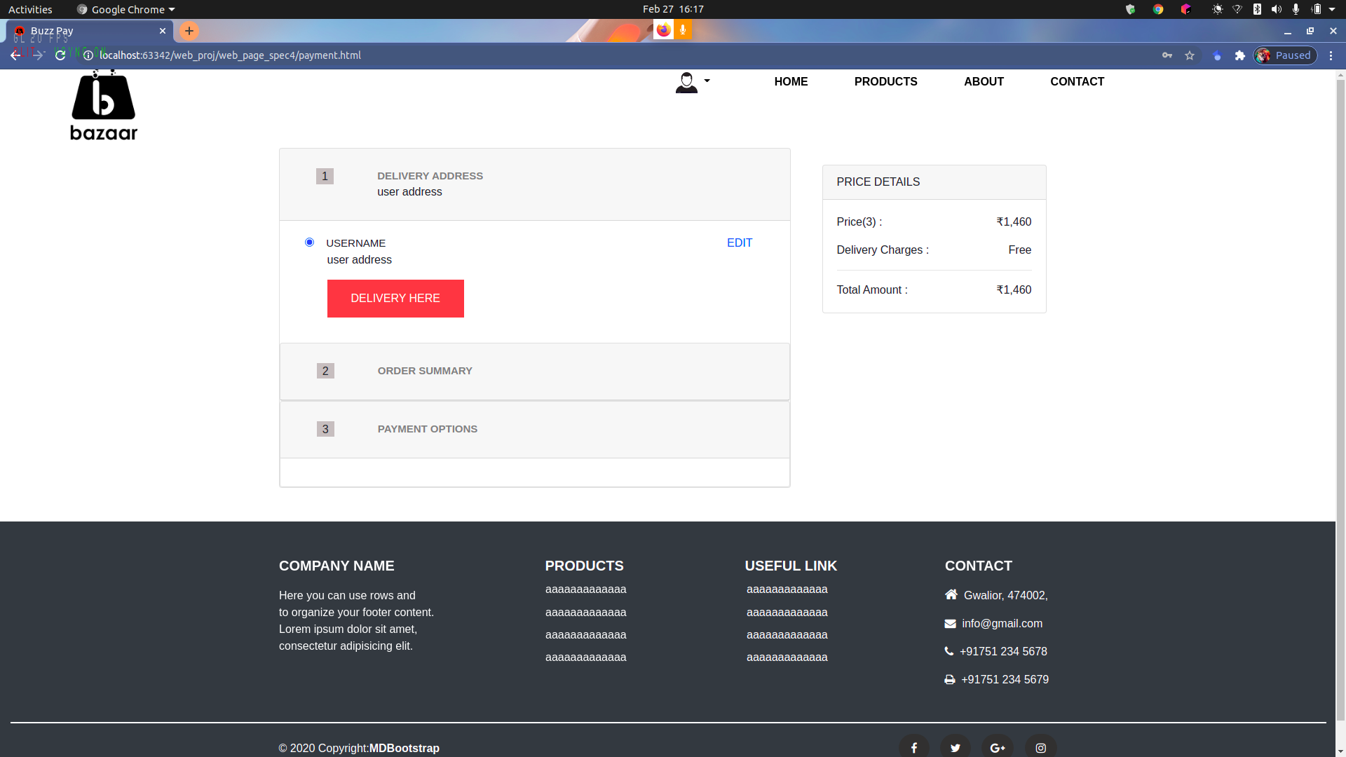

Slide 9
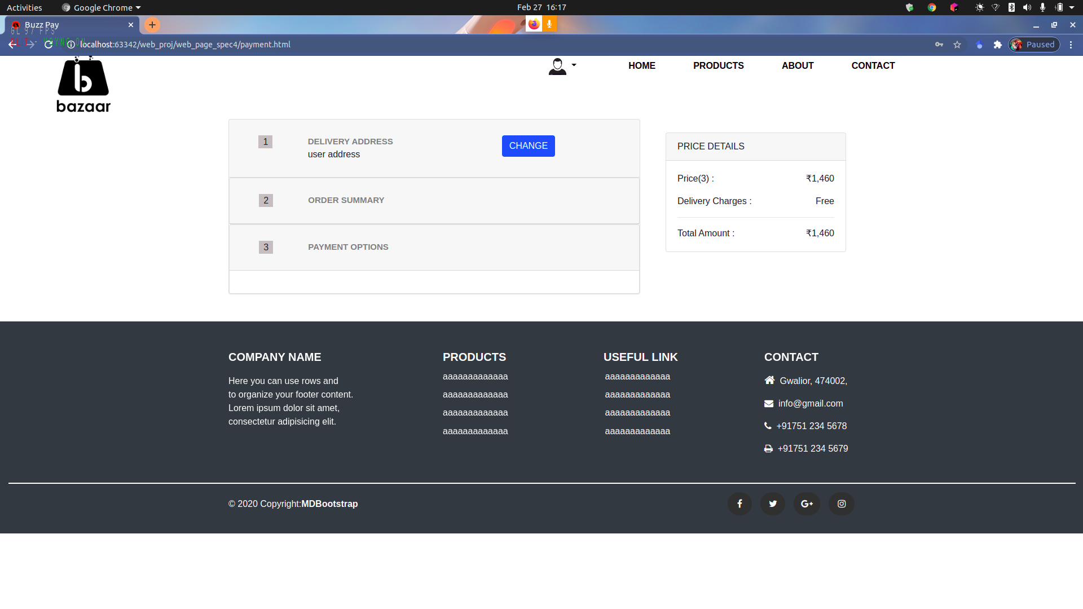


Slide 10


Slide 11
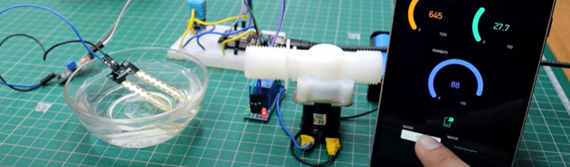
HARDWARE

Slide 12
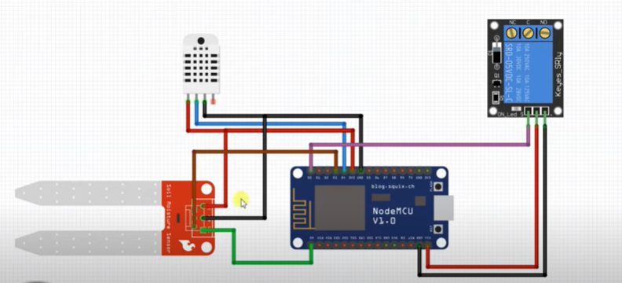

Slide 13
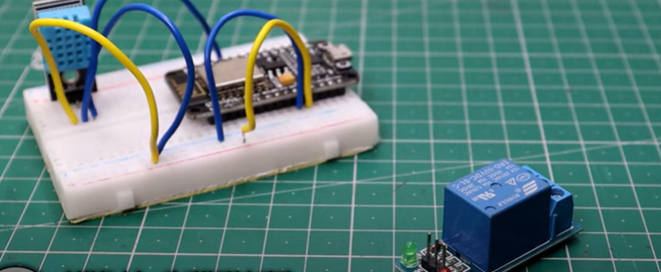
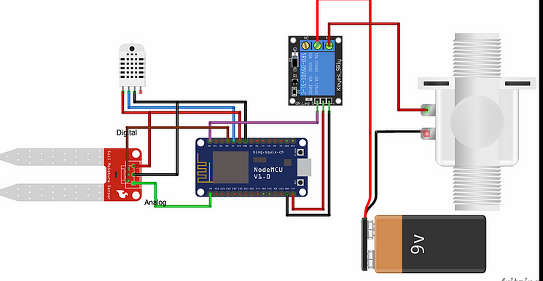

Slide 14
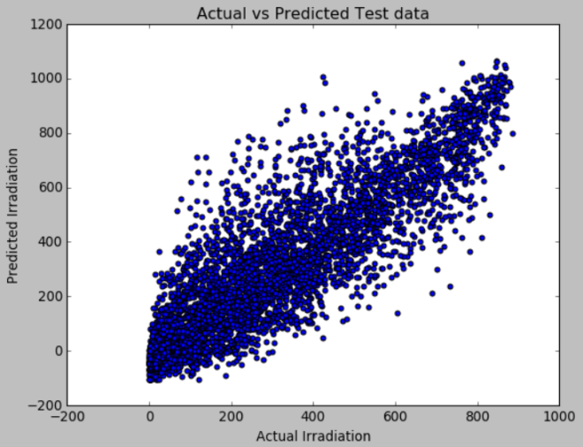
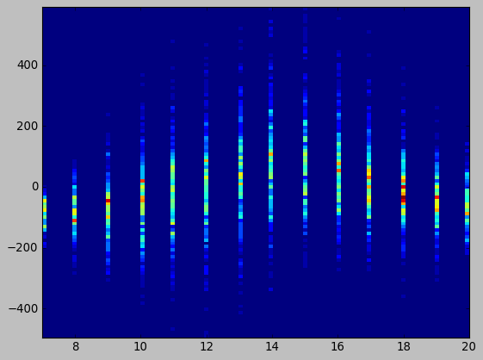
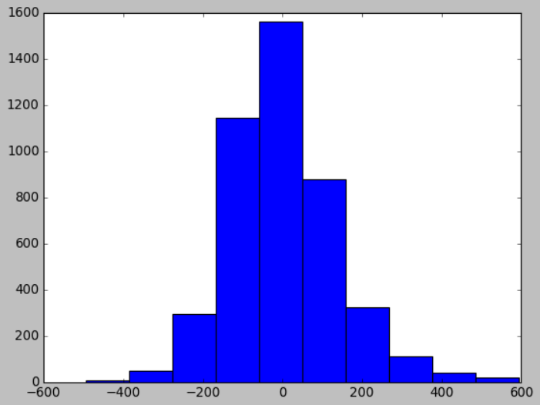
RESULTS & DISCUSSIONS
The project defines the quality checking of crop successfully. It helps in establishing a proper connection between weather conditions and its effect on the growing crops.
Output is as follows;

Slide 15
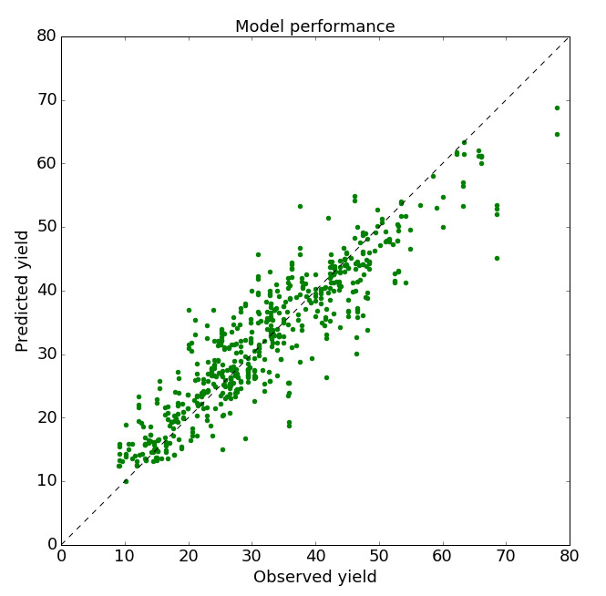
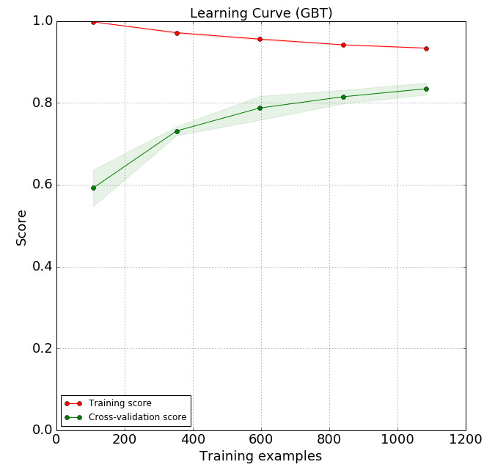
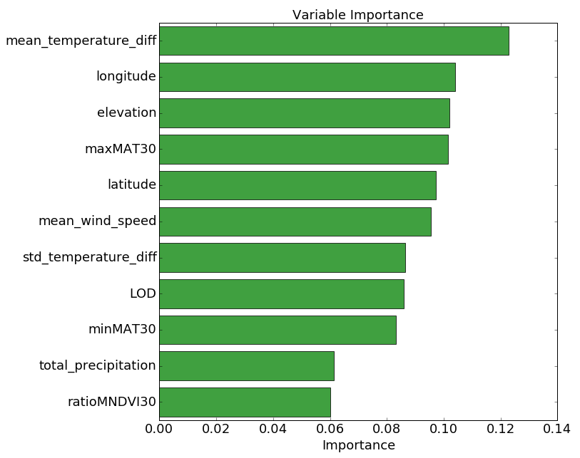

Slide 16
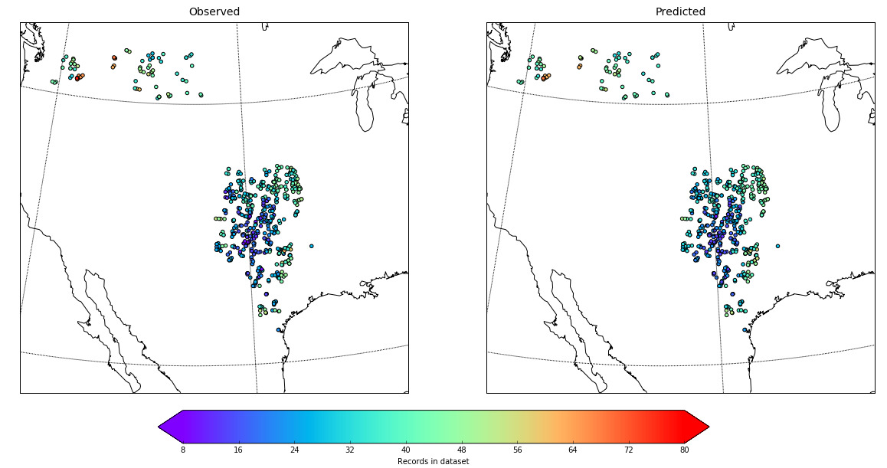

Slide 17
CONCLUSION
This is a project created at ground level hence with basic necessities. We can formulate it more with various advanced evolutions in future.
We have thought of some advanced versions;
1. We can grab a Raspberry Pi board & with the help of various sensors & devices, we could grasp the parameters like temperature, pH of soil, humidity, ambience of field, etc. directly from hardware which right now we’re taking from Weather predicting models. Also we’d be keeping the models as it is to get the result with more accuracy & perfection. As of now, we aren’t using noises but in the advanced development, we can use filters to work with noises.
2. Crop quality check is an important technique also in Market development. We can launch an application to connect the buyers & farmers. This would help both the sellers & consumers in various different aspects. Also f inancially, as the middle agent system would be demolished.

Slide 18
REFERENCES
MohsenHayati, and Zahra Mohebi,”Application of Artificial Neural Networks for Temperature Forecasting,” World Academy of Science,Engineering and Technology 28 2007.
http://ijcsit.com/docs/Volume%207/vol7issue3/ijcsit2016070396.pdf
Arvind Sharma, Prof. Manish Manoria,” A Weather Forecasting System using concept of Soft Computing,” pp.12-20 (2006)
Raúl Rojas,” The back propagation algorithm of Neural Networks - A Systematic Introduction, “chapter 7, ISBN 978-3540605058
www.ijettjournal.org › volume-3 › issue-1
K.M. Neaupane, S.H. Achet,” Use of backpropagation neural network for landslide monitoring,” Engineering Geology 74 (2004) 213–226.
https://statisticsbyjim.com/regression/predictions-regression/
http://www.wunderground.com/history/airport/VABB/2010/9/1/CustomHi story.html?dayend=1&monthend=9&yearend=2011&req_city=NA&req_ state=NA&req_statename=NA [6] lai l.l. et al.” Intelligent weather forecast” Third international conference on machine learning and cybernetics, shanghai, 2004
www.sciencedirect.com
(Songsheng Li)"Prediction of Body Temperature from Smart Pillow by Machine Learning", Mechatronics and Automation (ICMA) 2019 IEEE International Conference on, pp. 421-426, 2019.

